Slide 1
Agile, Continuous Delivery and DevOps at Qlik
Tips for your SaaS Cloud Journey
Jim Reed
Qlik Software Development Manager
Scalable Nodes Team
November 20 2017

Slide 2
Agile, Continuous Delivery and DevOps at Qlik
Tips for your SaaS Cloud Journey
Part I: Continuous Delivery and DevOps Tips
Go to prod early and often.
Split big features into thin slices.
Build a safety net.
Release features as a series of experiments.
Own your service in prod.
Part II: Agile Development on the Scalable Nodes Team
Part III: Reflections on our SaaS cloud journey so far

Slide 3
About Qlik
Elastically Scalable
Cloud/Hybrid Architecture
SaaS cloud products
Traditional on-premise software product
BI Software Company
40,000+ customers
2500 employees
On a SaaS & cloud journey
R&D Labs in Sweden, Boston, Italy, Iceland, Ottawa
100 employees in Ottawa
Qlik

Slide 4
About Me
Development Manager on the Scalable Nodes Team at Qlik.
We work on the new elastic cloud architecture for Qlik Sense.
Passionate about developing highly motivated teams that build great products they are proud of.
4 years
18 years
SaaS & cloud
on-premise
My SaaS cloud journey

Slide 5
Part I: Continuous Delivery and DevOps Tips
Tip #1: Go to prod early and often

Slide 6
Tip #1: Go to prod early and often
Qlik Sense releases every 10 weeks.
on-premise
release
continuous delivery release
We deploy Qlik Sense Cloud to prod every day

Slide 7
Tip #1: Go to prod early and often
What is Continuous Delivery?
Rather than deploy large batches to production
code commit
feature
prod
feature
deployment pipeline

Slide 8
Tip #1: Go to prod early and often
Continuous Delivery
can always release to prod
deploy smaller batches
build a deployment rhythm
Deploy small batches instead
feature
prod
feature
deployment pipeline

Slide 9
Tip #1: Go to prod early and often
New build refreshed everyday at noon.
A few minutes after deploy people noticed a a big slow down in performance.
8-10 changelists to review.
Fix was deployed about an hour later.
Performance issue on my first Continuous Delivery project
Perf tests run on new builds once a week, but sometimes they don’t work, so sometimes 3-4 weeks between tests performance tests.
40+ components changed.
100’s of changelists.
If there is a problem, it could take weeks to figure out what caused it.
Much better than
What I was used to with enterprise product development
My Continuous Delivery Epiphany Moment
Notes:
life cycle of fixing a performance issue

Slide 10
Tip #1: Go to prod early and often
Pick a release cadence and process that works for your team so you can deploy with confidence.
Don’t merge to master unless you are confident your change is ready to go to prod.
prod
deployment pipeline
You don’t have to wait until your process is fully automated.

Slide 11
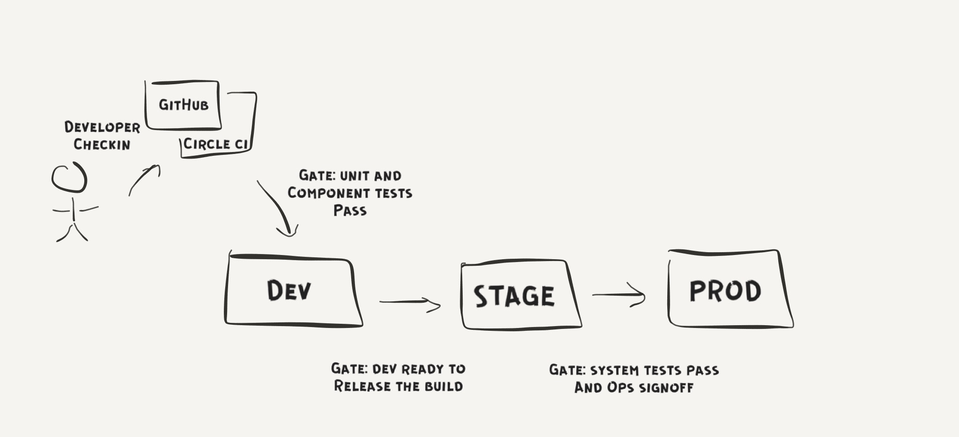
Tip #1: Go to prod early and often
Qlik Sense Cloud
Continuous Delivery Pipeline

Slide 12
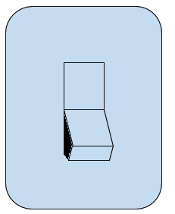
Tip #1: Go to prod early and often
Feature Flags
New features can be broken up into small pieces and delivered hidden under feature flags. Great to try things out in prod before your customers do. Great to make employees your guinea pigs.

Slide 13

Tip #1: Go to prod early and often
Quicker feedback
Higher quality
Simplifies deploys
Benefits
Increased release predictability
Don’t have to remember that configuration setting you added two months ago
You get good at releasing when you do it everyday

Slide 14
Part I: Continuous Delivery and DevOps Tips
Tip #2: Split big features into thin slices

Slide 15
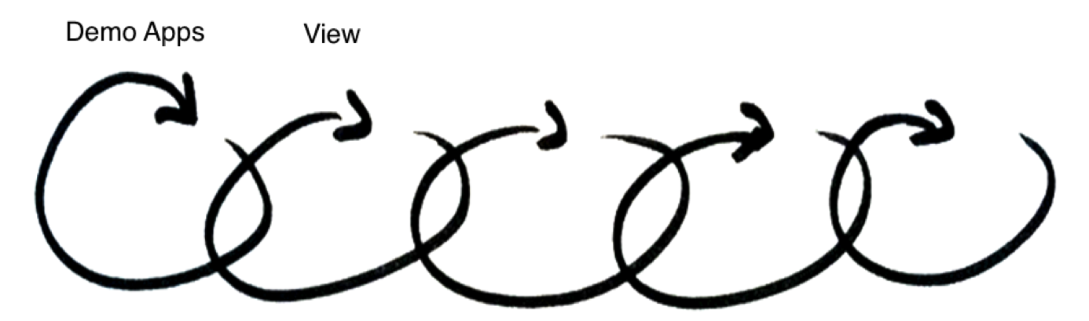
Tip #2: Split big features into thin slices
Phase 1 of Scalable Nodes
Strategy:
Iteratively deliver slices of functionality
Tackle risks early
Go to prod quickly, find problems quickly
…start with demo apps

Slide 16
Tip #2: Split big features into thin slices
Quicker feedback
Tackle risks early
Benefits
Production hardened
components prior to go-live
Start building up production expertise sooner

Slide 17
Part I: Continuous Delivery and DevOps Tips
Tip #3: Build a safety net

Slide 18
Tip #3: Build a safety net
First Production Phase of Scalable Nodes
Before we released the first production phase of the Scalable Nodes project we went through a production hardening phase that lasted a few months.

Slide 19
Tip #3: Build a safety net
Development Timeline

Slide 20
What were we doing?
Tip #3: Build a safety net
?
Development Timeline

Slide 21
Tip #3: Build a safety net
Building our cloud safety net
When a developer merges a change into master it can make it to prod later that day.
Our safety net is the collection of tools and processes we use to ensure we can do this with confidence.

Slide 22
Our Cloud Safety Net
Tip #3: Build a safety net
Metrics dashboards
Performance testing
Health-checks
Alerts
Monitoring
Unit testing
Security testing
System testing
Code reviews
Continuous delivery
Logging
Integration testing
Deployment pipeline

Slide 23
Tip #3: Build a safety net
monitoring
continuous delivery
metrics dashboards
alerts
bug fixing
deployment pipeline
health checks
performance testing
logging
unit testing
security testing
Development Timeline
system testing

Slide 24
Tip #3: Build a safety net
Production Hardening
“Getting it working is only 25% of the work”

Slide 25
Tip #3: Build a safety net
Logging & Monitoring
A great start is to capture information about traffic and errors.

Slide 26
Tip #3: Build a safety net
before
Resource Consumption Dashboard during performance tests. These tests were executed before and after stability bug fixes.
Memory leak before but not after
after
Docker mistakenly restarting engine before but not after
Notes:
thorough round of performance testing

Slide 27
Tip #3: Build a safety net
Engine Memory Usage
Apps Loaded
Metrics Monitoring - Engine Metrics collected during the performance tests helped to diagnose the source of Docker container crashes.
Sessions Per User
Cache Hit Rate

Slide 28
Tip #3: Build a safety net
File Descriptor Growth
Grafana dashboards were used to quickly
determine the cause of service memory leaks
Go-routine Growth
Process Memory
Micro-service Metrics Dashboards

Slide 29
Tip #3: Build a safety net
Go-live with confidence
Much faster to debug complex issues
Benefits
Can answer the questions like:
How many people are using my feature?
How many requests have they made?
How many errors have they had?
Don’t have to wait until customers call to find out about issues

Slide 30
Part I: Continuous Delivery and DevOps Tips
Tip #4: Release features as a series of experiments

Slide 31
Tip #4: Release features as a series of experiments
Go-Live Release Experiments:
In prod dark, feature flag testing
Experiment with a small group of users
Experiment with all employees
Go-Live Experiment with all users
Notes:
controlled release plan

Slide 32
Tip #4: Release features as a series of experiments
actual results
expected results
Collect data and compare expected
results to actual results
If the results are bad, fix bugs and repeat

Slide 33
Tip #4: Release features as a series of experiments
Go-live with confidence
Get lots of practice in before go-live
Benefits
Customers did not see many issues
Found and fixed lots of issues

Slide 34
Part I: Continuous Delivery and DevOps Tips
Tip #5: Own your service in prod

Slide 35
Tip #5: Own Your Services in Prod
Problem Last Year: Production Ownership Issues
Too many services for a small ops team.
Ops time spent deploying microservices, no time to do Ops work or monitor quality.
Current approach not scalable for continuous delivery.
A few developers were keeping production running, it wasn’t sustainable.
SaaS & cloud
on-premise
One year after Qlik Cloud’s release
We needed to re-think our approach to improve quality and to utilize everyone to the best of their abilities.

Slide 36

Tip #5: Own Your Services in Prod
Solution: Service Champions
Each developer is a prime for a microservice.
Work with ops (SRE) and other developers to ensure we are successful in production.
Responsible for deployments and keeping an eye on their service in production.
Knows if their service has a high error rate and does something about it.
All of our developers on the cloud team are champions for at least one service.
More equitably distributes support work across developers.

Slide 37
Tip #5: Own Your Services in Prod
ATC (Air Traffic Controller)
In addition to Champions, the Scalable Nodes team has a rotating daily triager that monitors all our team’s services to make sure they are healthy.

Slide 38
Tip #5: Own Your Services in Prod
Better distributes the support load across the team
Owning your service in prod makes you a better developer
Benefits
Find problems before they become major issues
More scalable way to support prod when you have a large number of microservices

Slide 39
Part I: Continuous Delivery and DevOps Tips
DevOps
It’s the processes, tools and strategies used to help build an effective partnership between development and operations (or SRE team) to support the delivery of awesome cloud products.

Slide 40
Part II: Agile Development on the Scalable Nodes Team

Slide 41
Agile Development on the Scalable Nodes Team
Our approach to Agile Development
Planning
Standups
Demos
Pre-Planning
Retrospective
Rolling Five Sprint Plan
Predictability
When is a story done?
Notes:
elements of our agile process

Slide 42
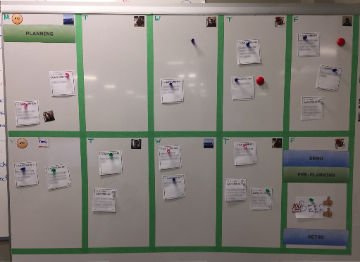
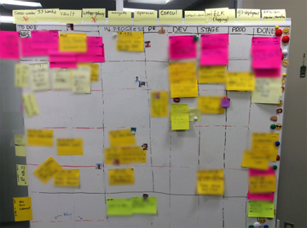
Agile Development on the Scalable Nodes Team
Planning:
Scrum process, two week sprints.
Stories are sized and have acceptance criteria before the planning meeting.
We like small stories.
We try to split big stories into smaller ones or break into smaller tasks.
Validate our plan using a physical scrum board with a calendar view.
Switched to this from a traditional status view scrum board. Block off time in calendar for meetings and interviews.
If it takes time, it has points.
status view
calendar view

Slide 43
Agile Development on the Scalable Nodes Team
Standups
Standups:
We really like the physical board.
Don’t get distracted by trying to type and talk at the same time.
The calendar view makes it easy for us to see if we are tracking according to plan.
Always remind ourselves, what is our demo, are we still able to demo.

Slide 44

Agile Development on the Scalable Nodes Team
Demos
First thing in the morning on the last day of the sprint (Friday) we demo with some teams in Sweden.
More of a show and tell, just the highlights, not details of every story.
Sometimes we attend a second demo with Ottawa teams in the afternoon.

Slide 45
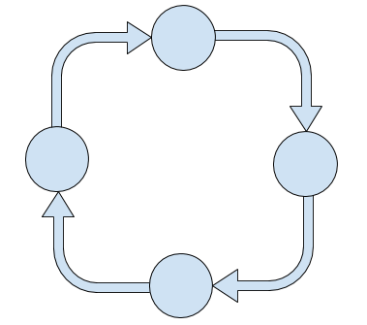
Agile Development on the Scalable Nodes Team
Pre-Planning
Spend 1/2 a day after the demo on Friday getting ready for the next sprint.
Look at our backlog plan to help set goals.
Create stories as a group, agree on acceptance criteria and size using planning poker.
Use a whiteboard more than the computer.
Try to avoid 1 person typing and 6 people checking their cell phones.
When we plan well, we execute better.
Planning

Slide 46
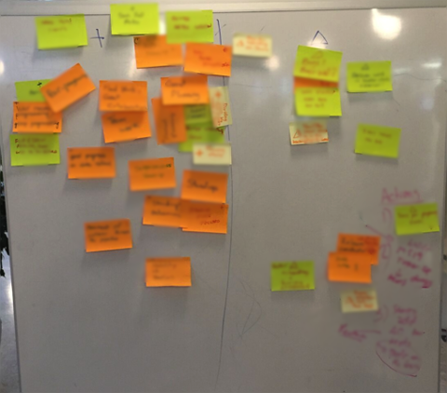
Agile Development on the Scalable Nodes Team
Retrospective
Friday afternoon with a beer.
What went well, what could improve?
What experiments do we want to try next sprint?

Slide 47
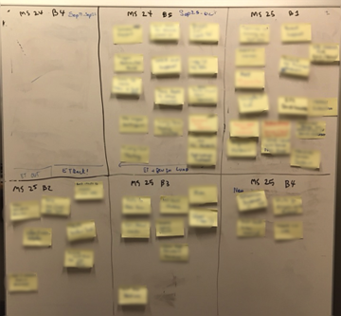
Agile Development on the Scalable Nodes Team
Rolling Five Sprint Plan
We organize the top of our backlog into a rolling five sprint plan.
Once a sprint, we update the plan (usually).
Need to be diligent so it doesn’t turn into a 4 then 3 sprint rolling plan.

Slide 48
Agile Development on the Scalable Nodes Team
Travel & Recruiting
Designing the next release
Helping other teams
Predictability
One of our team’s goal this year is to increase predictability. We track planned vs achieved story points each sprint to measure estimation accuracy.
This worked for us because it was the team’s idea.
Very small team with focused plans
Onboarding new team members
Notes:
velocity, planned vs actual

Slide 49
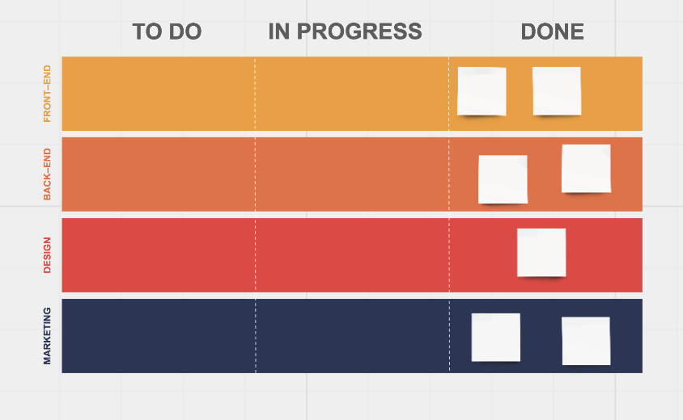
Agile Development on the Scalable Nodes Team
When is a story done?
A) merged to master
B) deployed to develop
C) deployed to production
D) verified in production

Slide 50
Part III: Reflections on our journey so far

Slide 51
Reflections on our journey so far
Building a “safety net” is a lot of work, but it’s worth it
When we plan well, we execute better
Things we Like
Thin slices are the way to go
We’ve learned a lot owning our services in prod

Slide 52
Reflections on our journey so far
Onboarding teams is a lot of work
Tooling requires a big investment
Challenges
Challenging to get alignment on the prod ownership model
Onboarding, helping teams and prod support impacts time available for feature development

Slide 53
Tips for your SaaS Cloud Journey
Final Thoughts
Also, don’t forget to Invest in your architecture
Part I: Continuous Delivery and DevOps Tips:
Go to prod early and often.
Split big features into thin slices.
Build a safety net.
Release features as a series of experiments.
Own your service in prod.
Part II: Agile Development on the Scalable Nodes Team
Part III: Reflections on our journey so far
SaaS & cloud
on-premise
Qlik’s SaaS cloud journey

Slide 54
Questions?

Slide 55
Thank you!!

